Slide 1
ReactPHP
Programowanie reaktywne w PHP
github.com/kardasz/react-php-examples

Slide 2
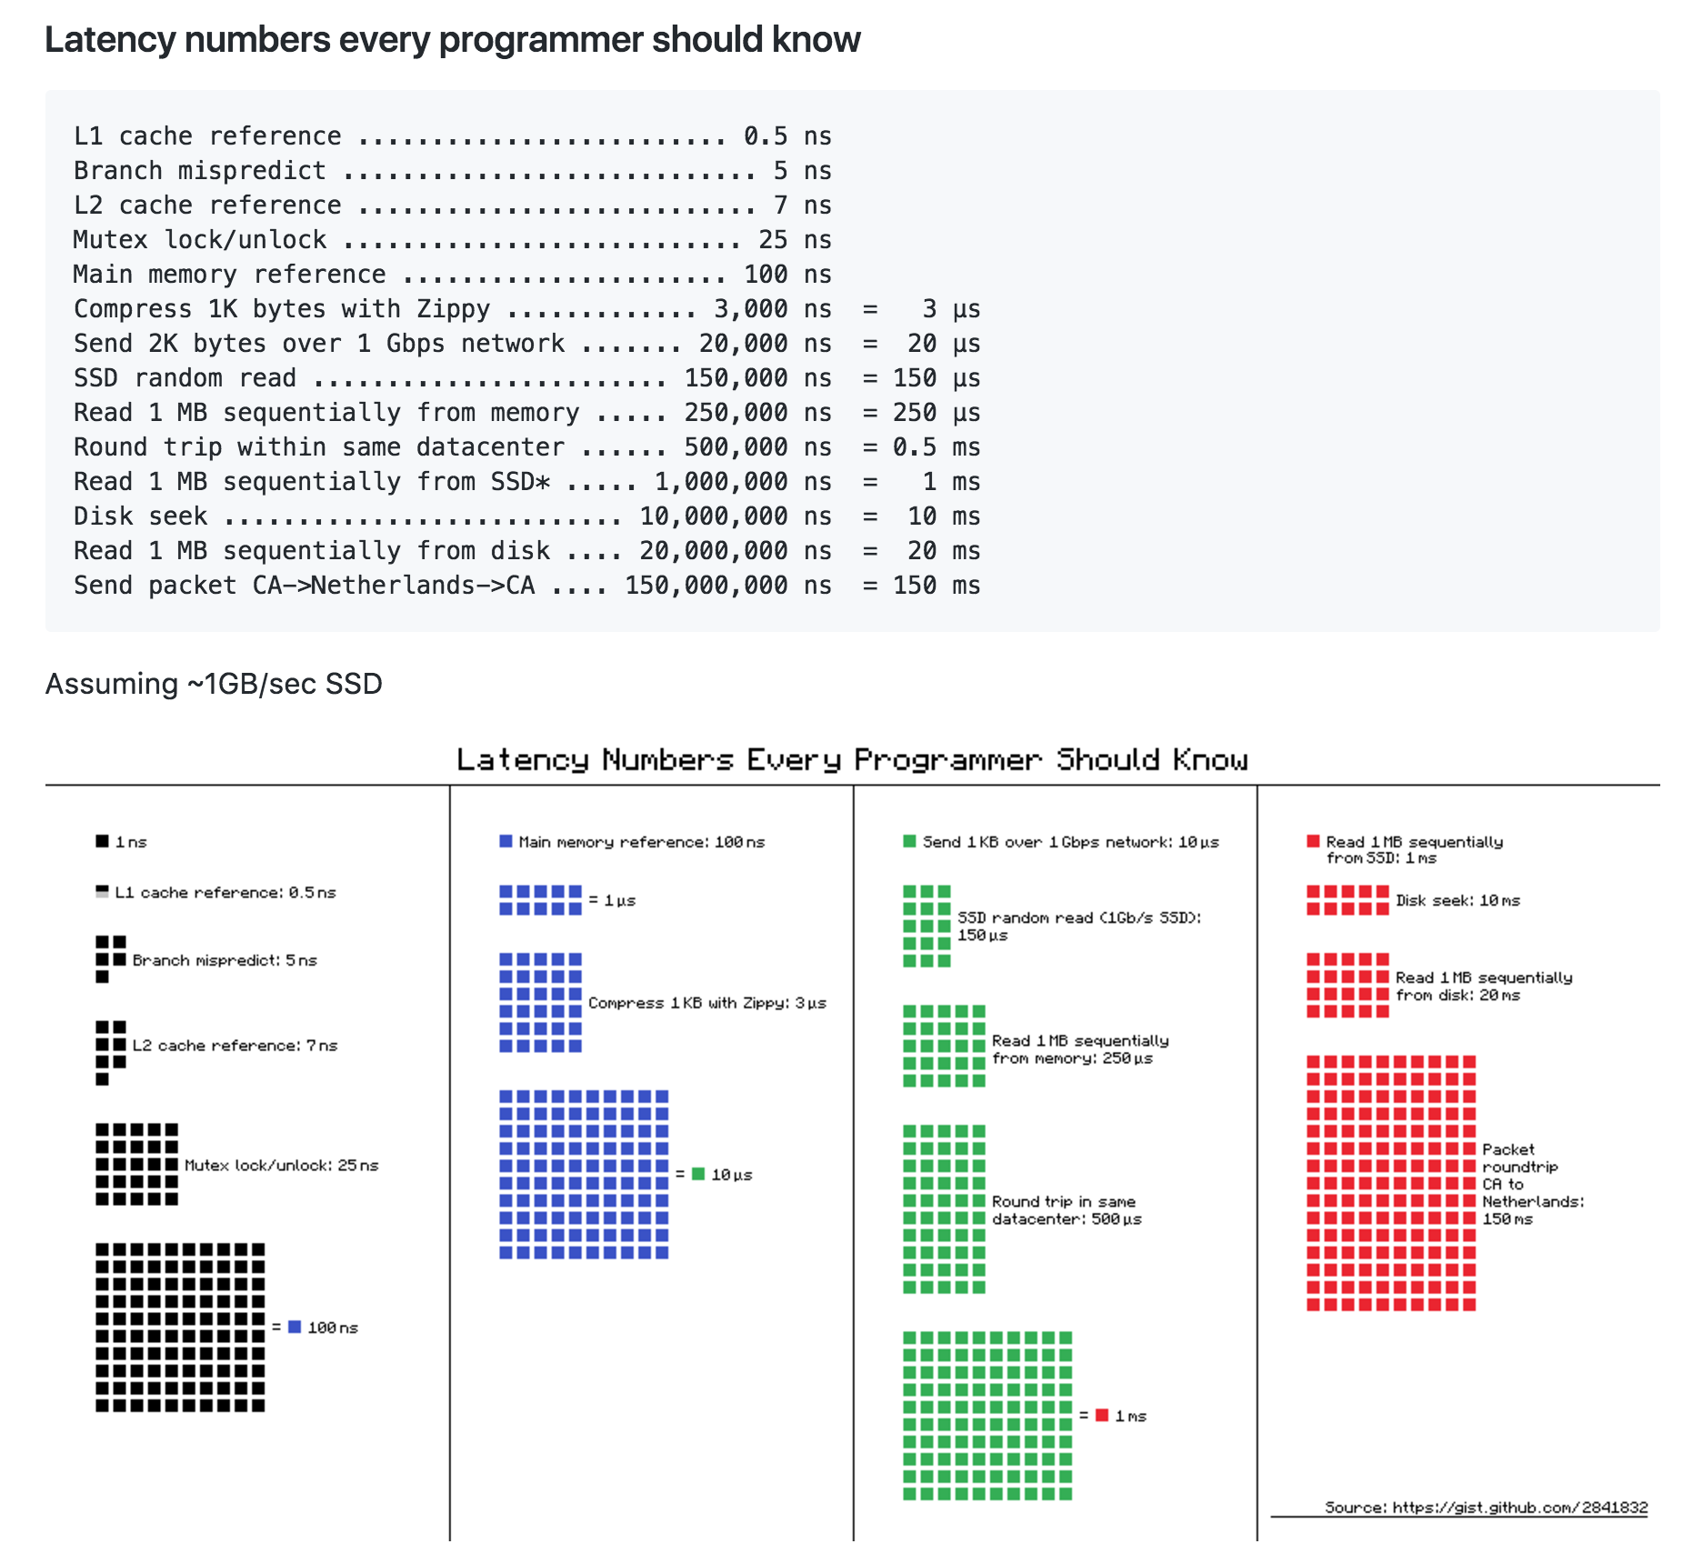
I/O is slow

Slide 3
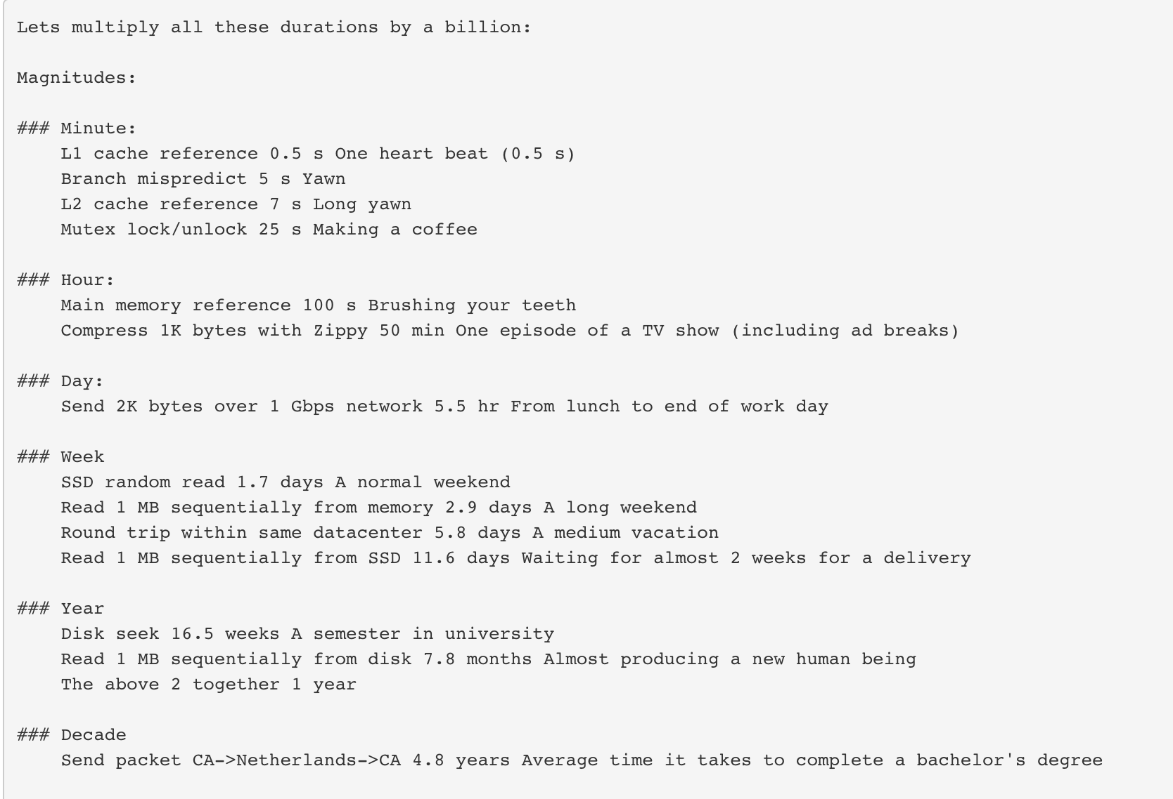
I/O is slow

Slide 4
Hardware is no longer the bottleneck
12 Cores Java/Linux
~ 12 million concurrent connections!
https://mrotaru.wordpress.com/2013/10/10/scaling-to-12-million-concurrent-connections-how-migratorydata-did-it/

Slide 5
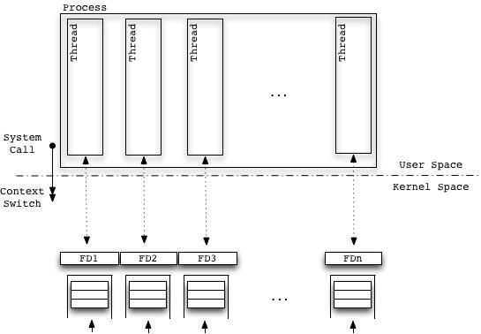
Multithreaded
Advantages No evident Bottleneck. Pure multi-processing (no level of indirection). Better Performances (no need to analyze events). Number of runnable Threads is potentially limited by the available Virtual Memory. The rule NumberOfCPUs * 2 + 1 is appropriate only in case of hard CPU-bound tasks, here we’re talking about mixed I/O-first and CPU-second tasks. Easier Code.
Disadvantages Higher number of Context Switches on average. Higher memory usage (as many Threads’ stacks as the number of FDs).

Slide 6
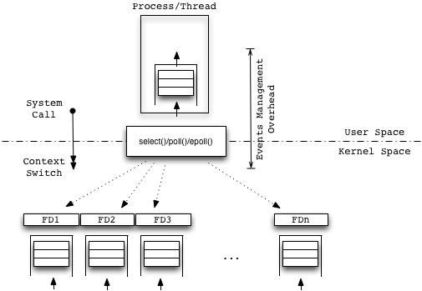
Single Threaded Non-Blocking I/O
Advantages Light Context Switches (User to Kernel mode).
Disadvantages Inefficient for Short-lived Connections (Events handling overhead and polling time can outweigh the current amount of work). Serial processing (from the Process/Thread perspective). Bottleneck (in the Event Loop). CPU-bound tasks executed serially kill the performances. Complex code. Complex debugging.

Slide 7
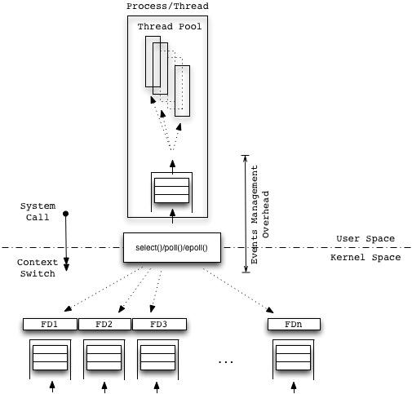
Multithreaded Non-Blocking
Advantages Light Context Switches (User to Kernel mode). Higher Scalability and better Performances in processing CPU-bound tasks.
Disadvantages Bottleneck (in the Event Loop). Multi processing is driven by a dispatcher, so delayed in time (before to start processing new stuff, a Thread has to be weaken up after the Dispatcher has analyzed the event itself); a time consuming level of indirection. Complex Code. Complex Debugging.

Slide 8


Non Blocking I/O - Solutions & examples
Multithreaded
but … consumes a lot of resources, like RAM
Multithreaded + Multiplexing
select/pool/kevent
consumes limited resources

Slide 9
select, pselect - synchronous I/O multiplexing
select() and pselect() allow a program to monitor multiple file descriptors, waiting until one or more of the file descriptors become "ready" for some class of I/O operation (e.g., input possible). A file descriptor is considered ready if it is possible to perform a corresponding I/O operation (e.g., read(2) without blocking, or a sufficiently small write(2)).

Slide 10
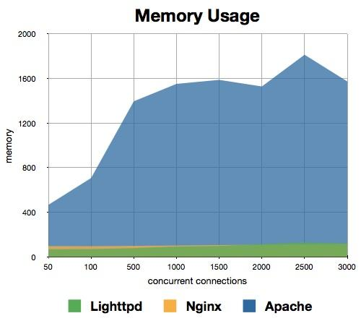
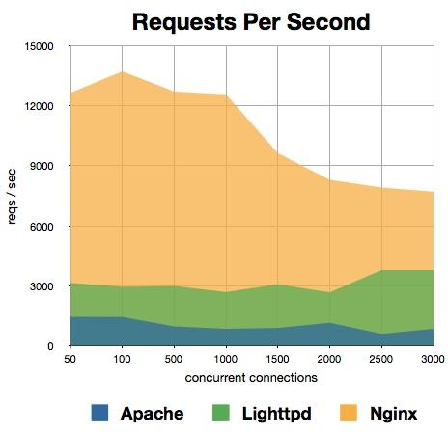
Lighttpd vs Nginx vs Apache

Slide 11
PHP

Slide 12
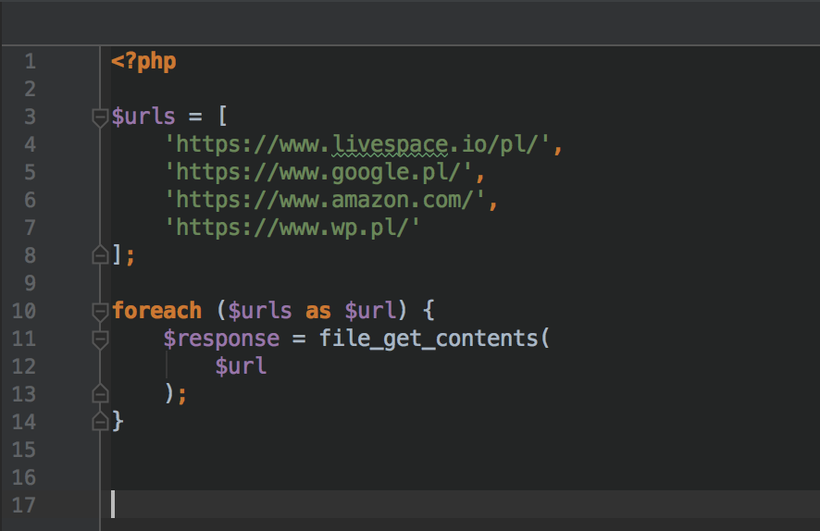
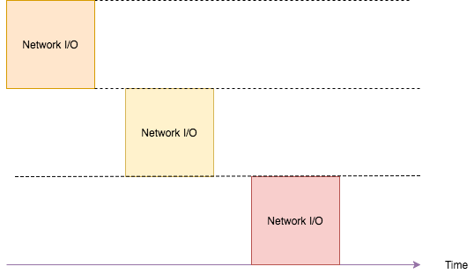
Blocking I/O

Slide 13
PHP
pthreads (cli only, OOP Threads)
popen() (one directional process file pointer)
proc_open() (bidirectinal process file pointer)
pcntl_fork() (cli only, C style forks)
socket_select() (Runs the select() system)
stream_select() (Runs the select() system)
stream_set_blocking() (blocking/non-blocking stream)
curl_multi_select()
Multithreded & Non-blocking I/O

Slide 14
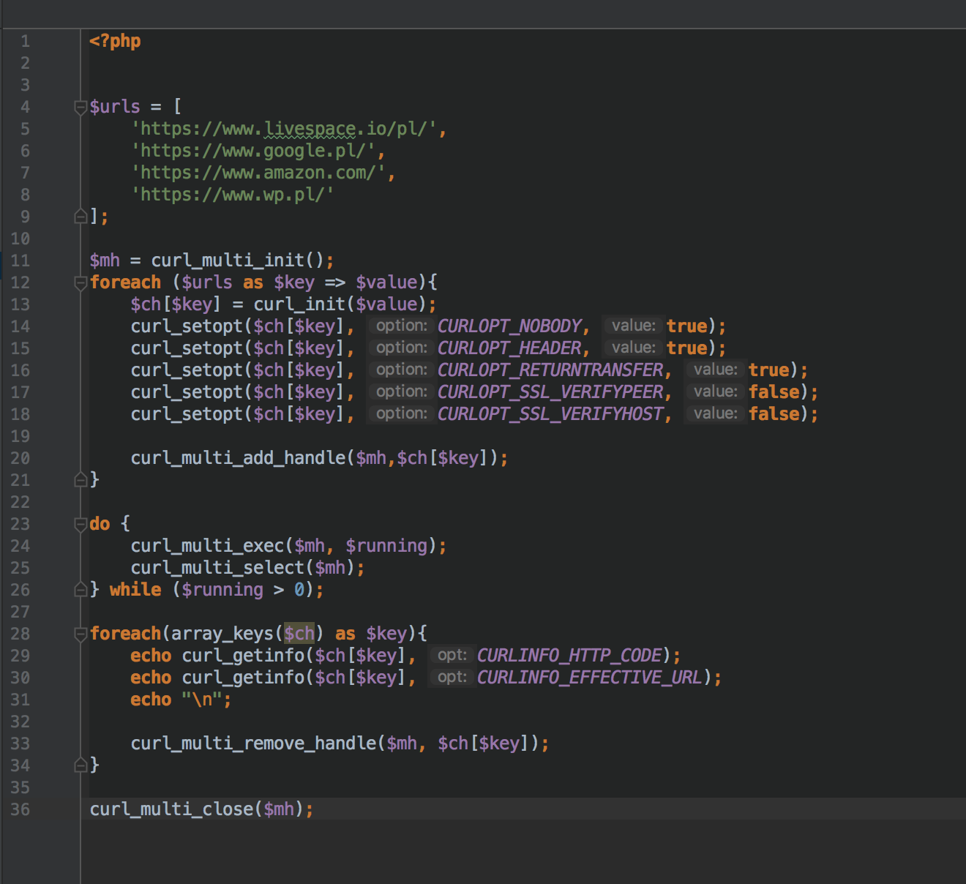
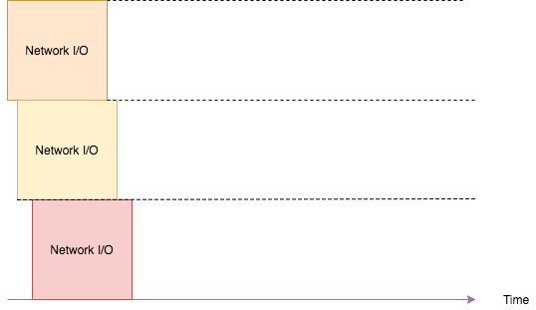
Non-Blocking I/O with curl_multi_select

Slide 15

React PHP
Event-Driven
Non-blocking I/O
PHP

Slide 16
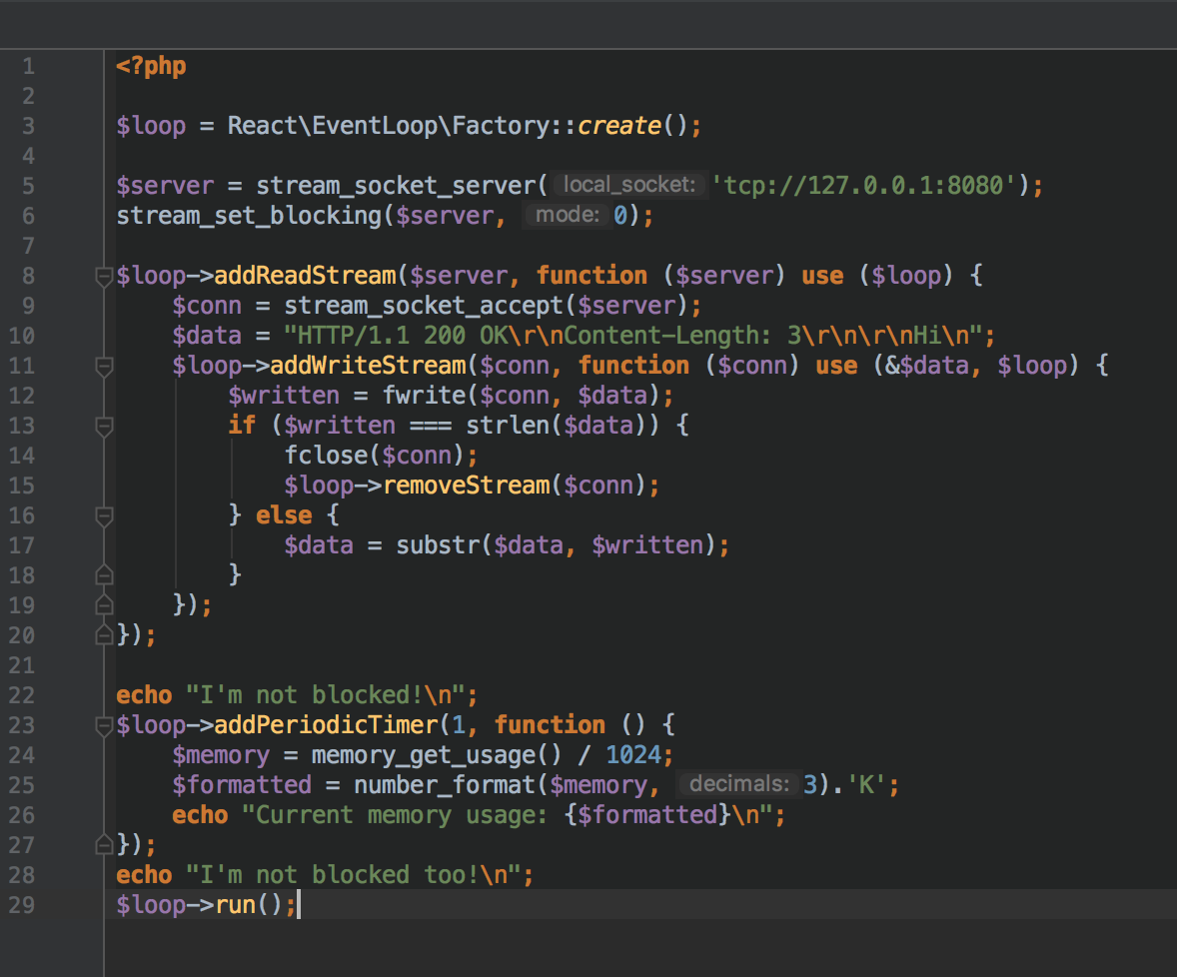
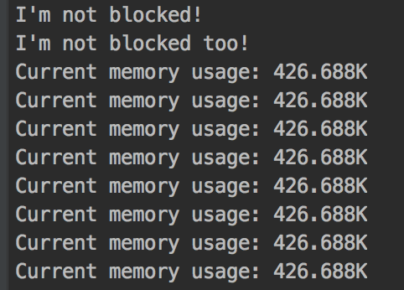
EventLoop

Slide 17
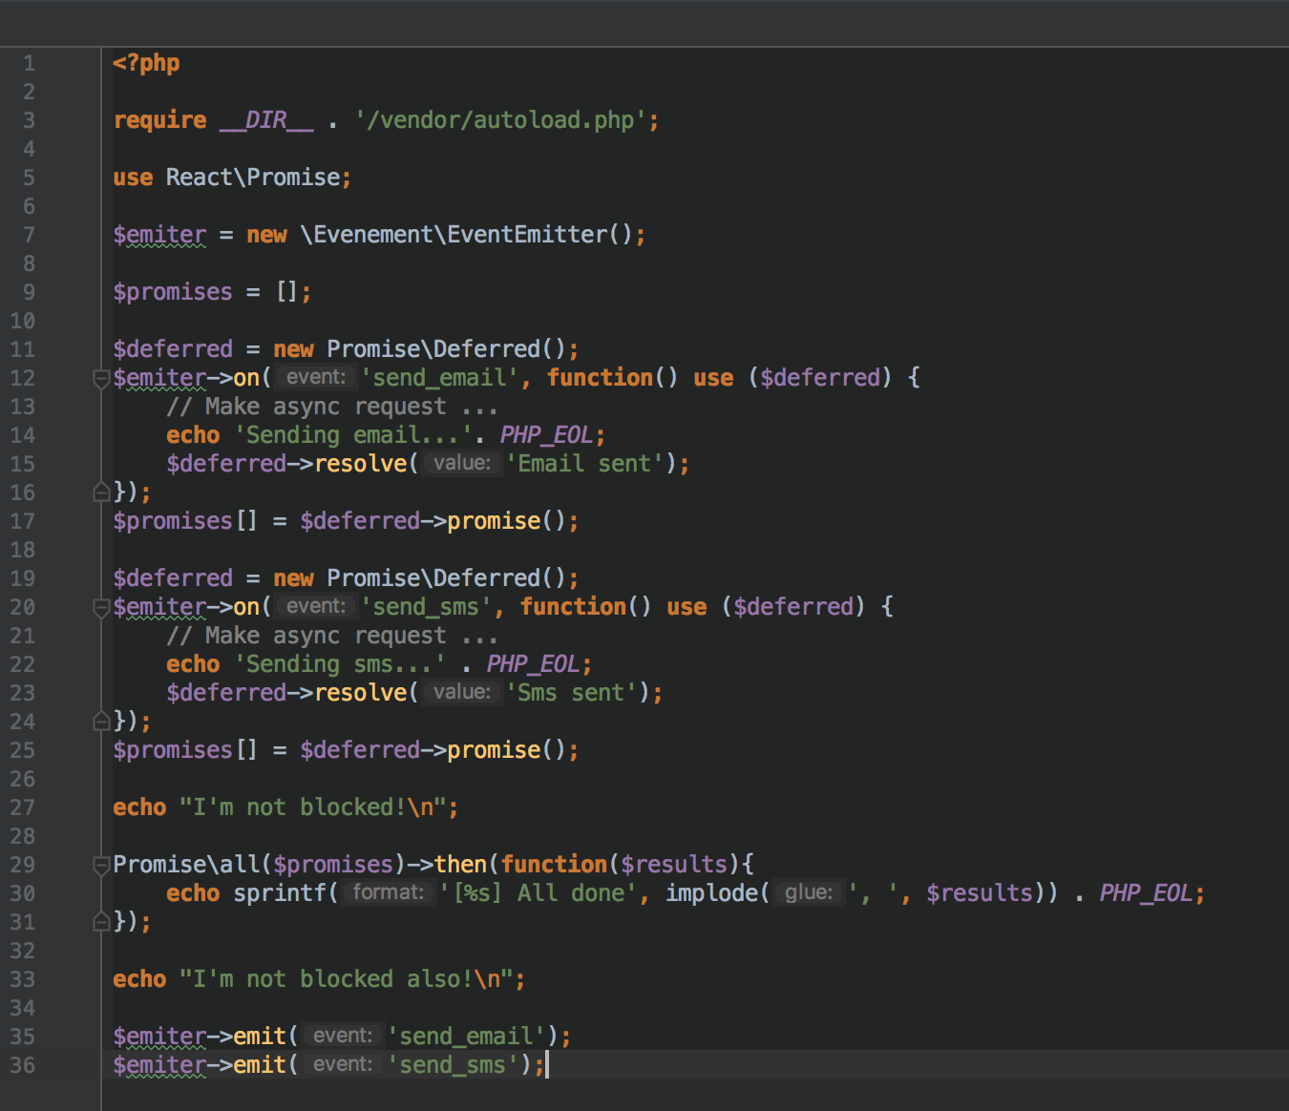
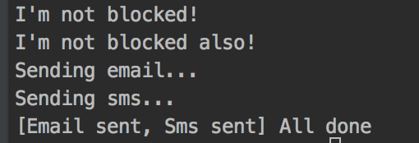
Promise

Slide 18
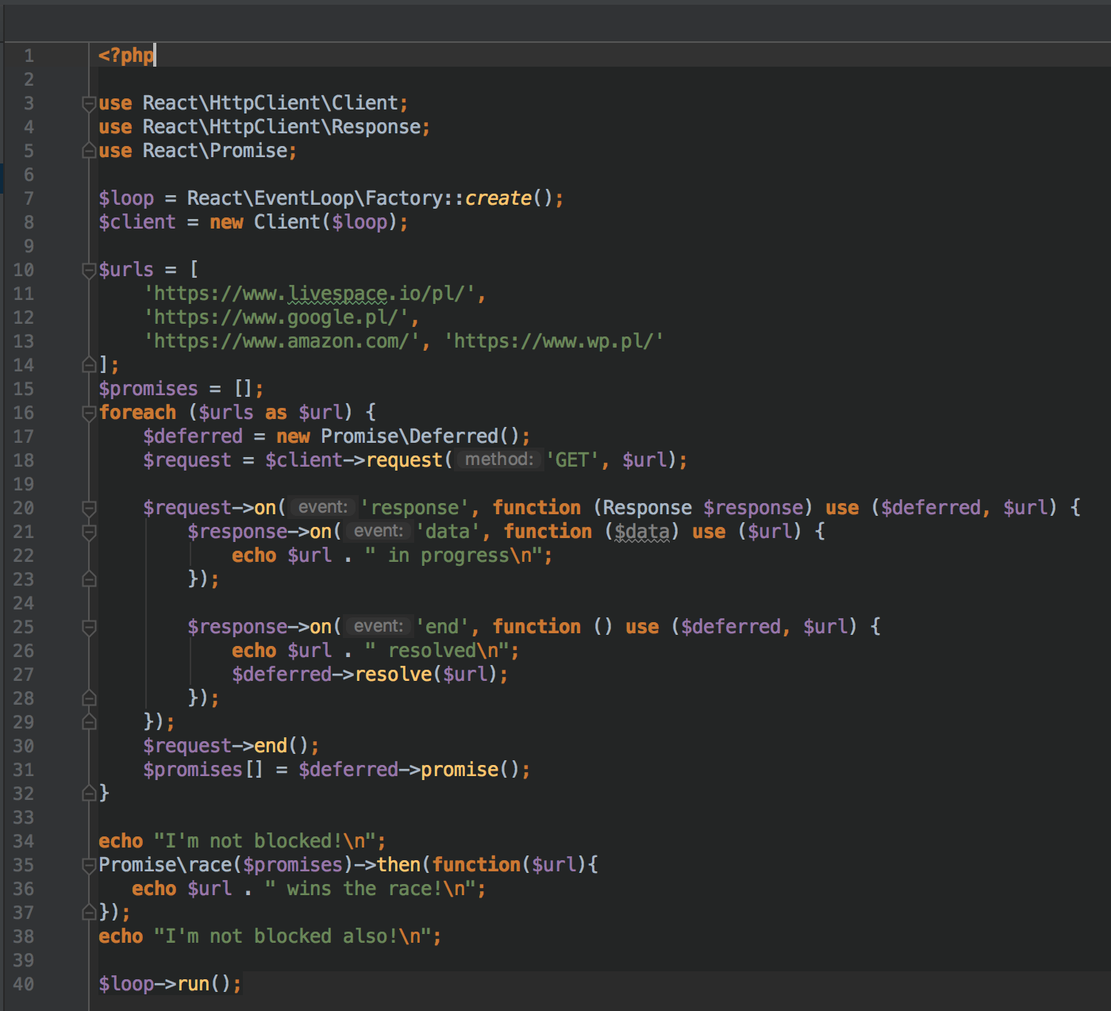
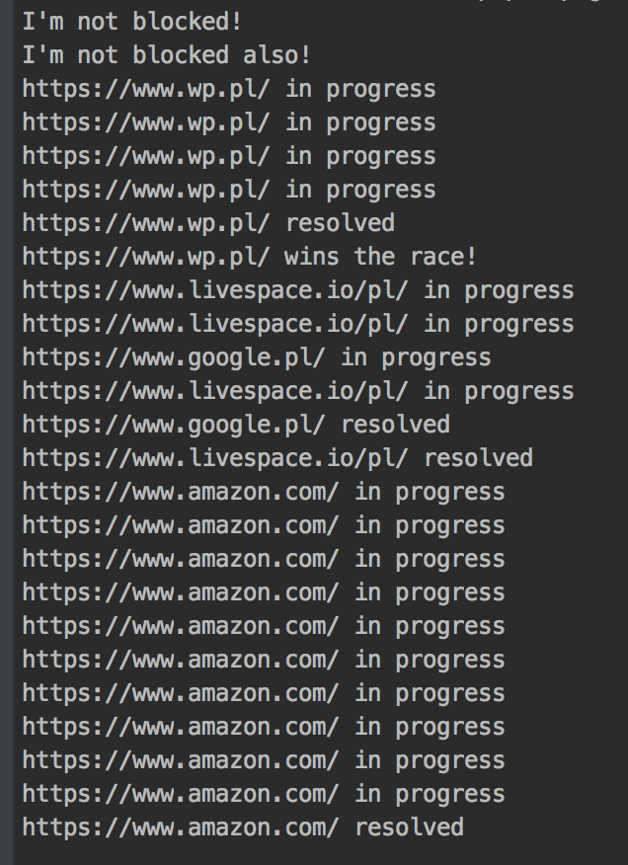
Non Blocking I/O with React PHP

Slide 19
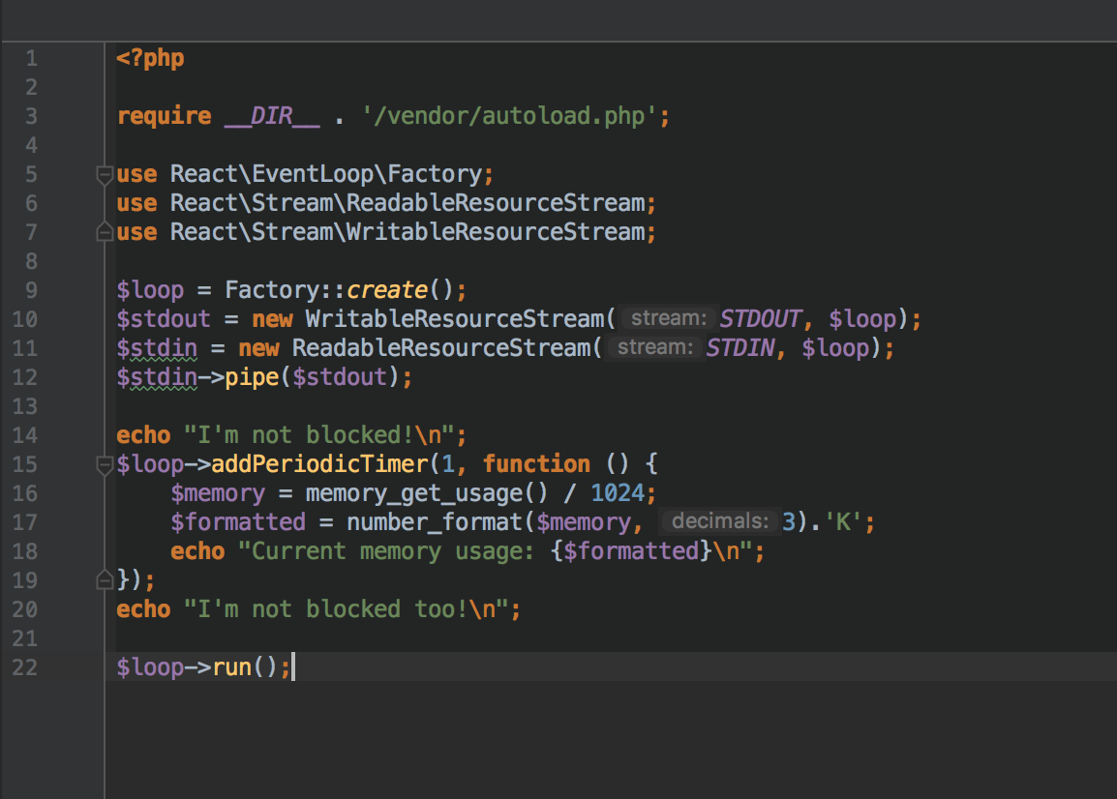
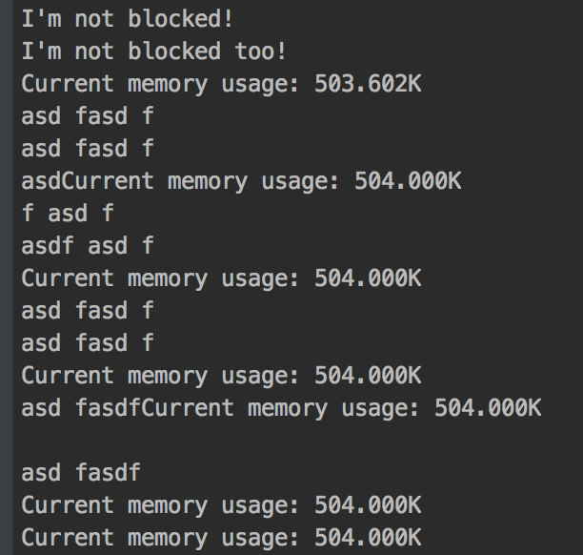
Stream pipe

Slide 20
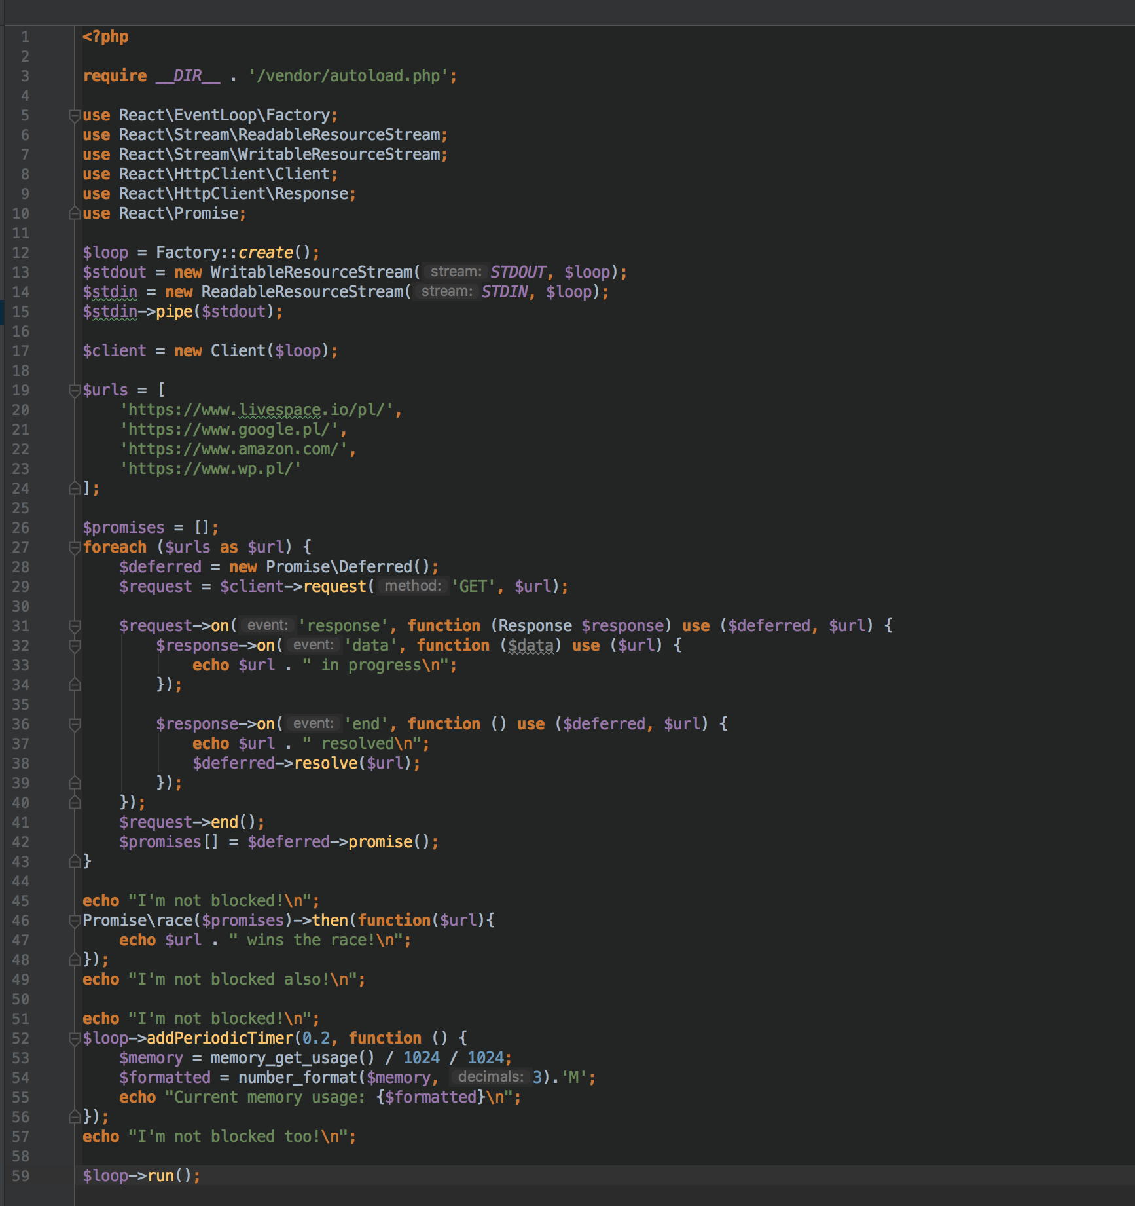
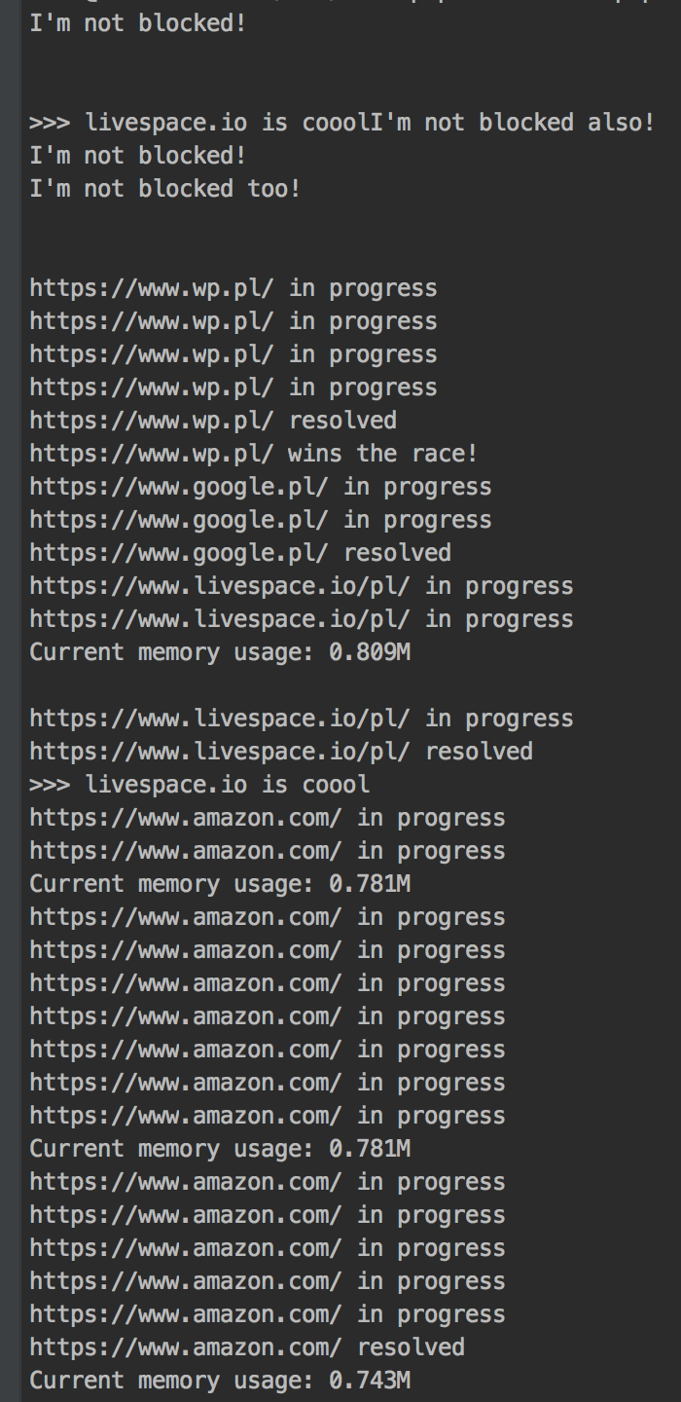

Slide 21
RxPHP
Streams
Filters
FlatMap
Observable
Scheduler
Promises
github.com/ReactiveX/RxPHP

Slide 22
Q/A

Slide 23
Thanks!

